Slide 1
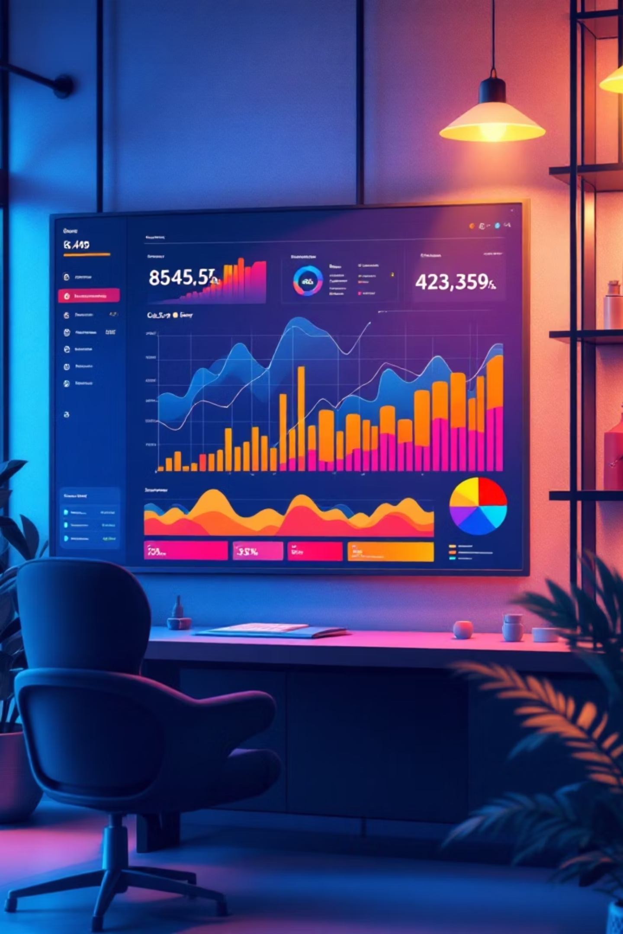
Customer Shopping Behaviour Analysis
Understanding how customers interact with products, pricing, and promotions to drive strategic business decisions and enhance customer satisfaction.

Slide 2
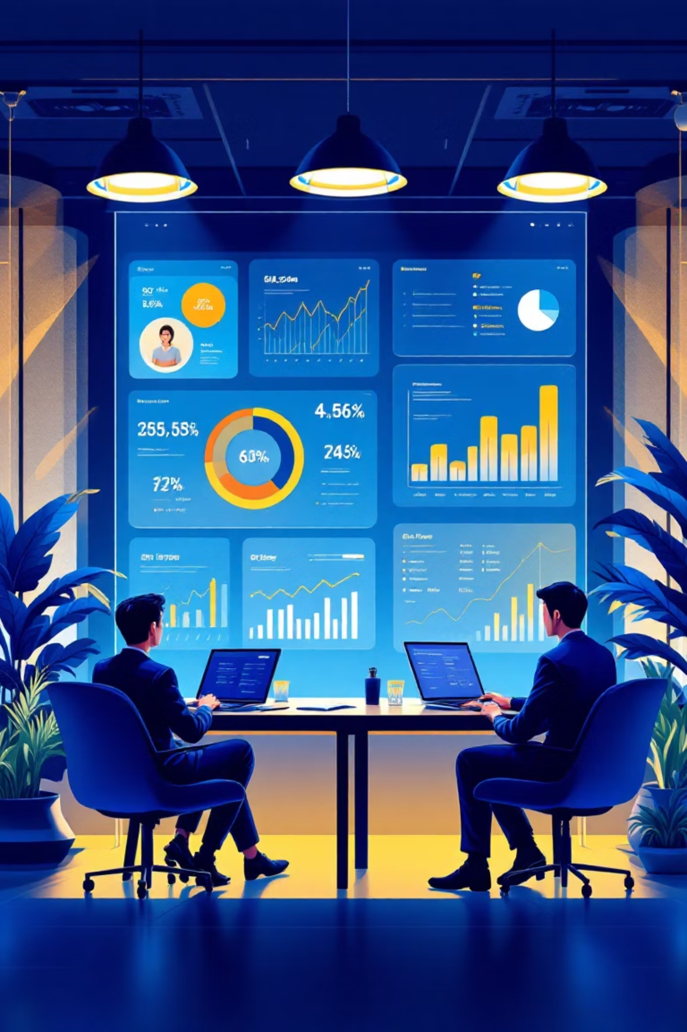

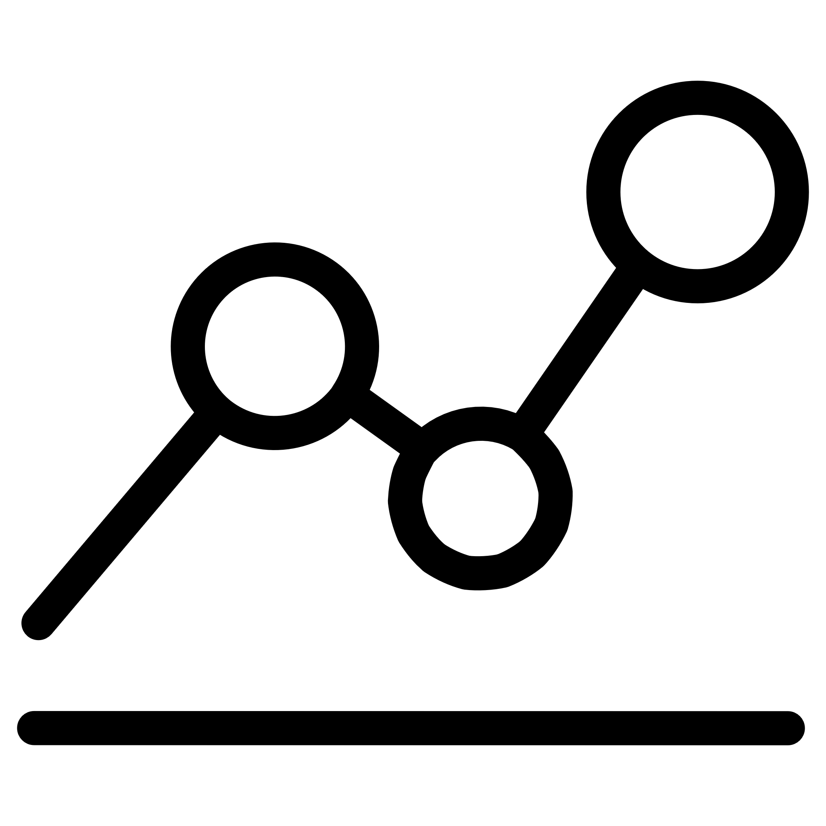

Project Objective
Analyze Purchase Data
Identify Patterns
Uncover meaningful insights from real customer purchase data to support strategic decision-making.
Discover what customers buy, how often they buy, and how much they spend.
Drive Strategy
Enable targeted marketing, personalized experiences, and optimized inventory management.

Slide 3

The Challenge
Problem Statement
Our Solution
Analyze structured customer data and present insights in a simplified, visual format to improve marketing effectiveness, increase revenue, and boost customer loyalty.
Many retail businesses struggle with:
Unorganized customer data
Poor marketing decisions
High inventory costs
Low customer retention

Slide 4
Tools & Technologies
Microsoft Excel
SQL Analysis
Power BI
Data cleaning, removing duplicates, handling missing values, and organizing data using VLOOKUP, FILTER, and Pivot Tables.
Extract insights through queries using GROUP BY, WHERE filtering, and aggregate functions to understand purchase patterns.
Create interactive dashboards with charts, slicers, KPIs, and DAX measures for visual representation of trends.

Slide 5
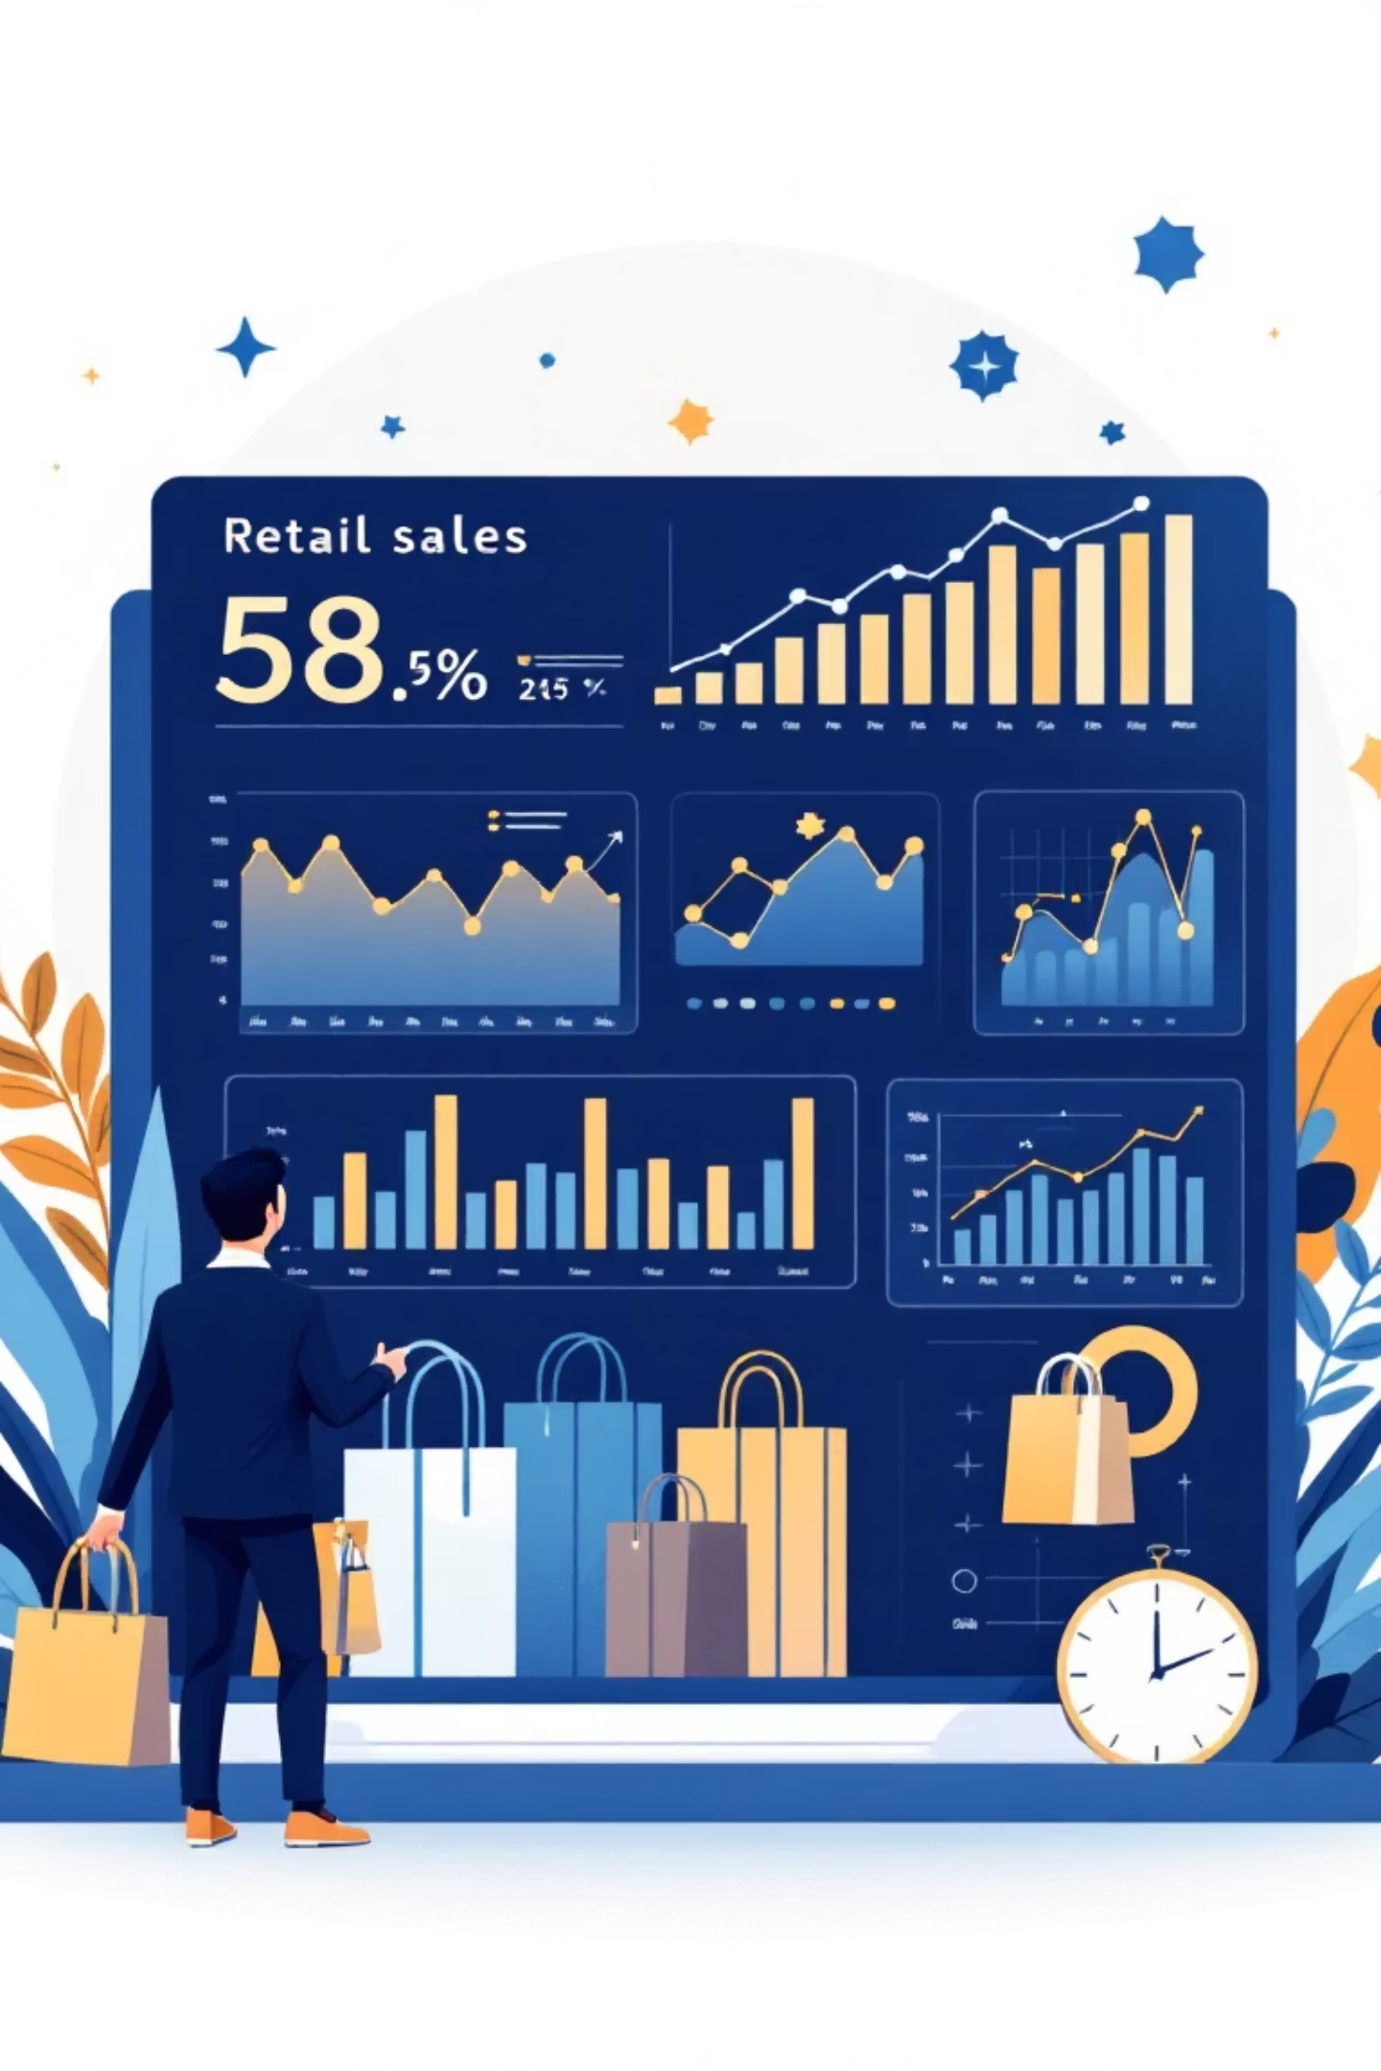
Sales Performance Insights
$233K
$100
Total Sales
Highest Transaction
Overall revenue generated across all categories and locations
Maximum amount paid by a customer in a single purchase
$20
Lowest Transaction
Minimum purchase amount recorded in the dataset
Top Selling Categories
Gender Distribution
Clothing leads with the highest sales, followed by Accessories, Footwear, and Outerwear.
Male customers contribute double the sales compared to female customers, representing a significant market segment.

Slide 6
Location & Product Analysis
1
2
3
Montana
Illinois
California
Top-performing location with highest total sales
Second highest sales location
Third in sales performance
4
5
Idaho
Nevada
Fourth highest revenue generator
Fifth top-selling location
Product Size Preferences: Medium size products dominate sales, followed by Large and Small sizes, indicating clear customer preferences for standard sizing.

Slide 7








Customer Behavior Patterns
Purchase Frequency
Review Ratings
Customers shop weekly, bi-weekly, fortnightly, quarterly, and annually with varying patterns.
Average customer satisfaction measured through review ratings indicates product performance.
Discount Usage
Subscription Status
Customers actively apply discounts, influencing purchase decisions and basket size.
Clear distinction between subscribed and non-subscribed users affects loyalty.

Slide 8

Seasonal & Demographic Trends
Seasonal Sales
Shipping Preferences
Sales vary significantly across Spring, Summer, Fall, and Winter, with distinct seasonal purchasing patterns affecting inventory planning.
Express, Standard, Free Shipping, Next Day Air, and 2-Day Shipping options show clear customer preferences.
Payment Methods
Age Segmentation
Credit Card, PayPal, Cash, Debit Card, and Venmo usage patterns indicate diverse payment preferences.
Customers segmented into age groups reveal purchasing behavior differences across generations, from young adults to seniors.

Slide 9
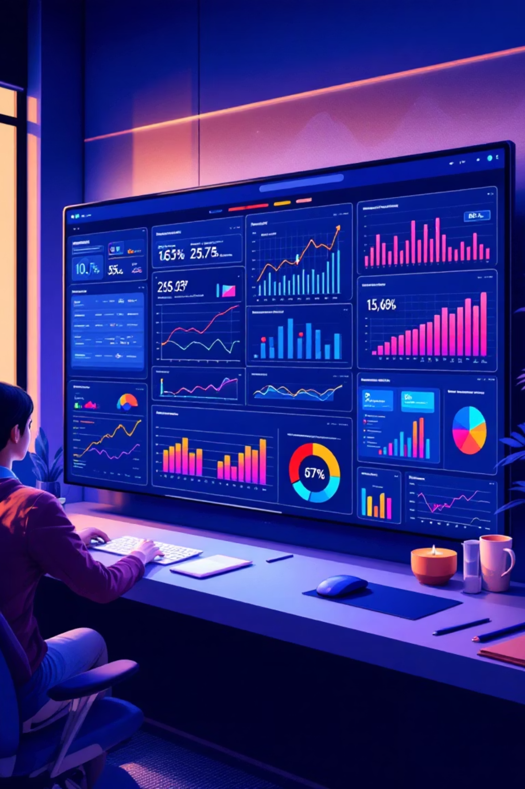
Interactive Power BI Dashboard
Developed an interactive dashboard analyzing retail sales and customer behavior with bar charts, pie charts, and KPIs. DAX measures and Power Query transformations enable dynamic exploration of revenue trends, customer preferences, and operational performance.
Total sales and top-selling products by color and location
Sales breakdown by season, size, and category
Customer segmentation by age, gender, and subscription status

Slide 10




Business Recommendations
Focus on Outerwear
Improve sales in the lowest-selling category through targeted strategies.
Align with Trends
Match production with customer preferences, market trends, and seasonal demand.
Target Male Consumers
Prioritize male-targeted products as they represent double the customer base to maximize revenue.
Analyze customer behavior and purchase patterns to design products that match customer tastes and drive market share growth.

